Slide 1
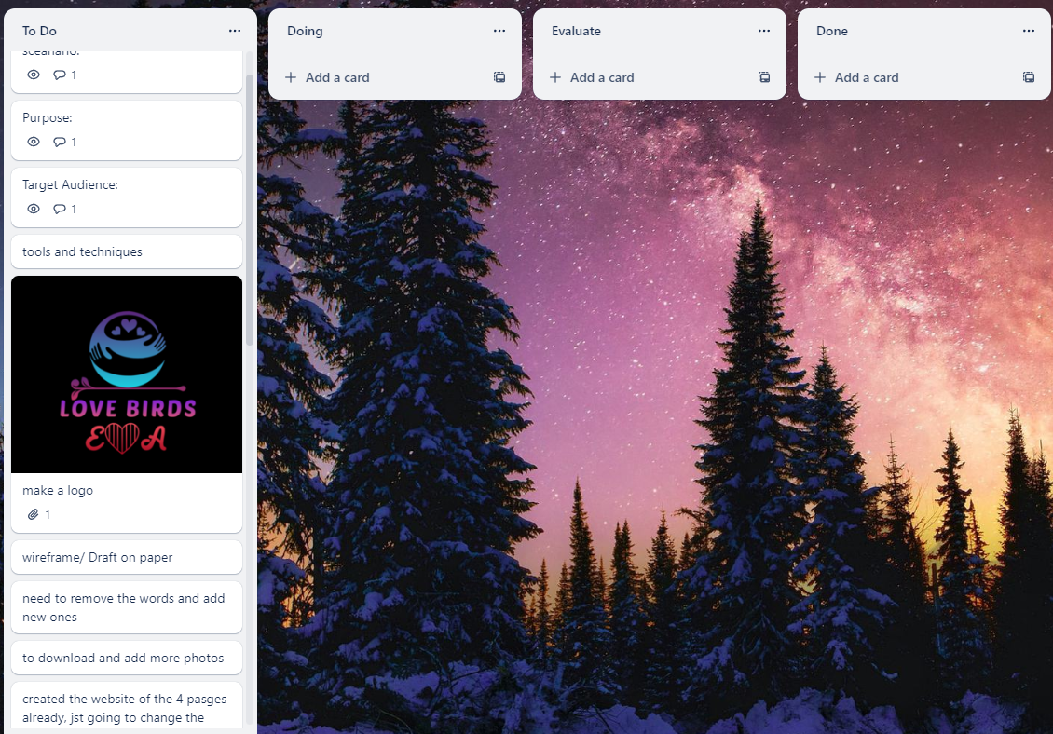
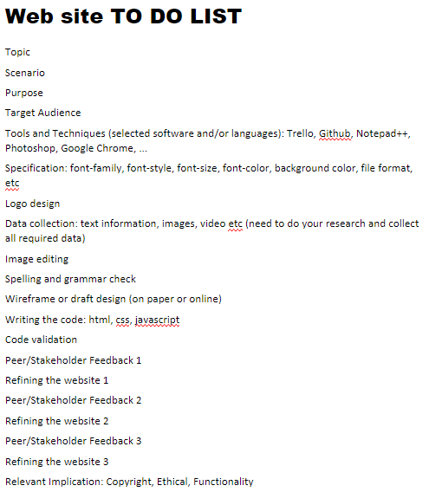
Project Management

Slide 2
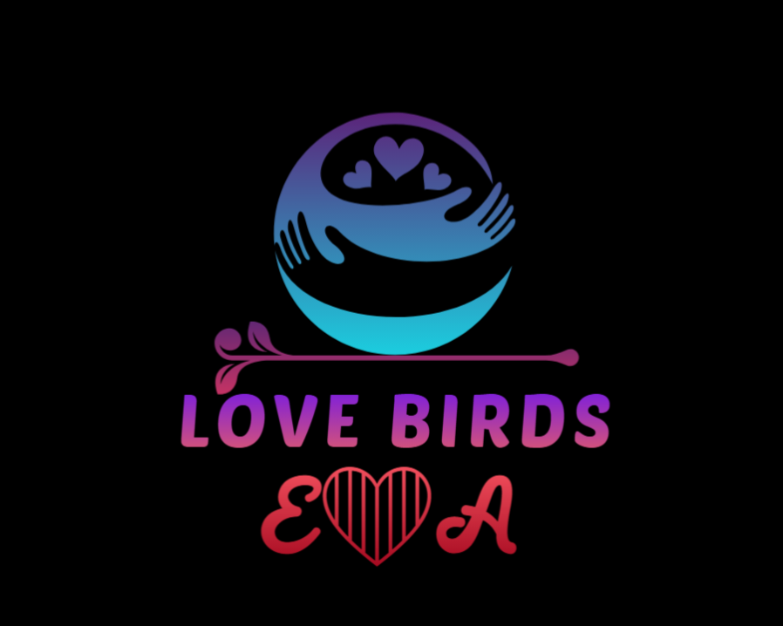
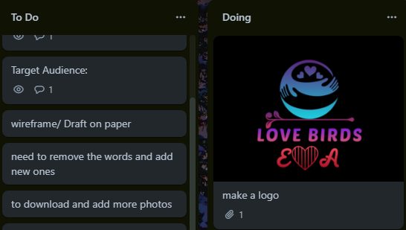
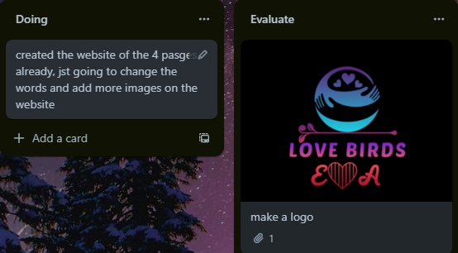
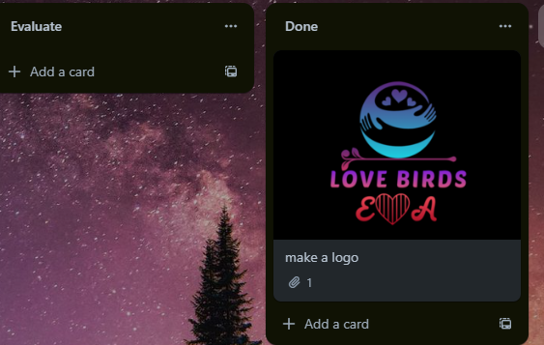
Logo design
The logo was design on a free logo website https://www.brandcrowd.com/maker/logos/page1?text=Lovebirds&isFromLogoHome=true#show-onboarding-modal
For the logo I only added the last line.
Peer and stakeholder discussion:
My peer disagreed on the background colour

Slide 3
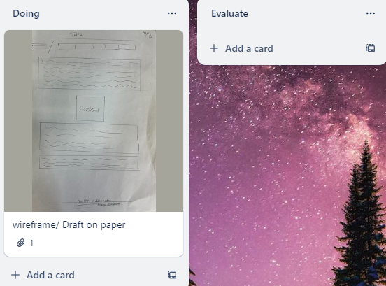
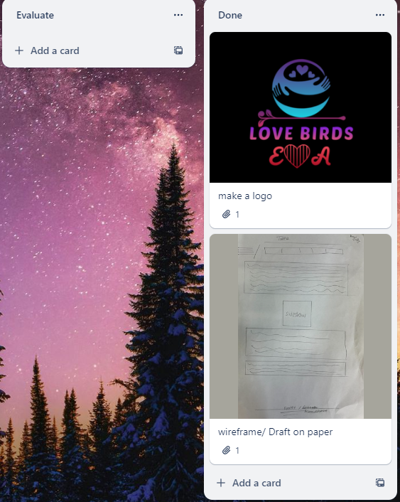
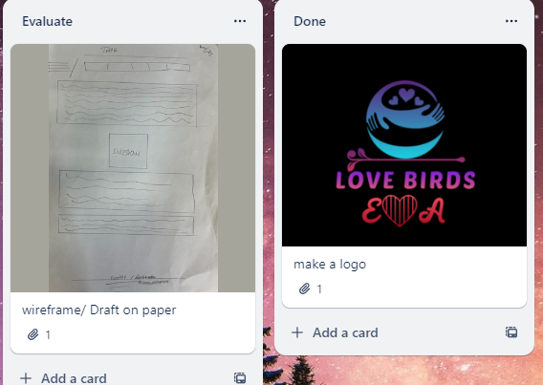
Wireframe design

Slide 4
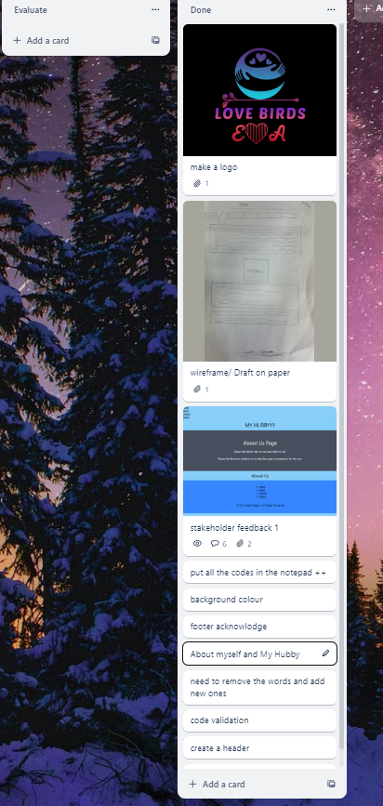
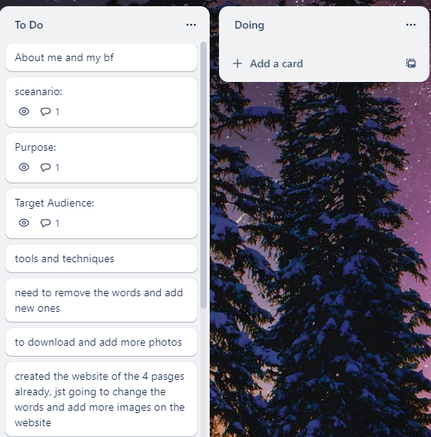
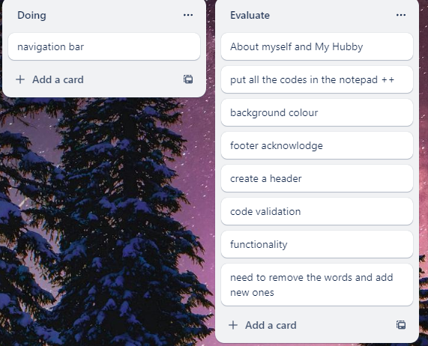
Research and data collection

Slide 5
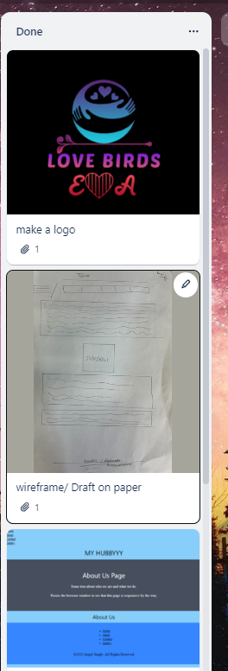
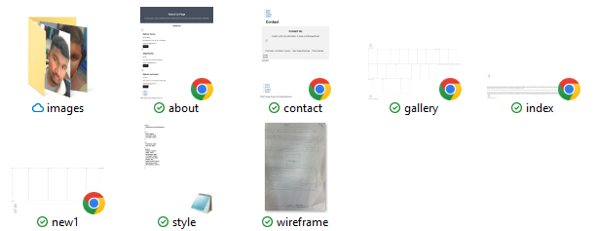
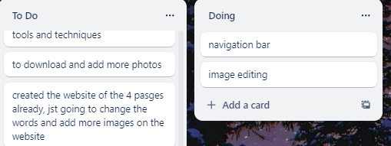
Image editing

Slide 6
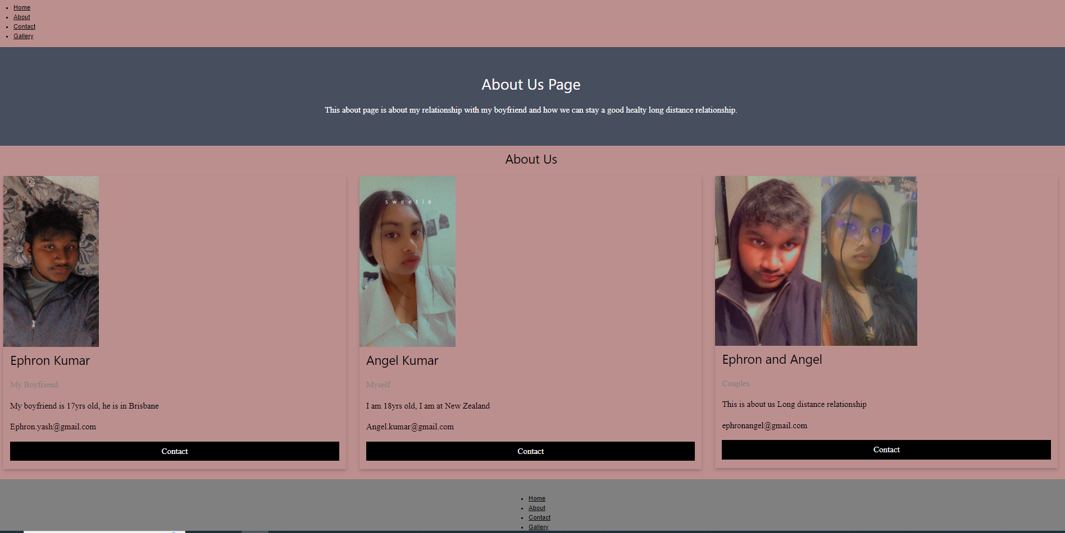
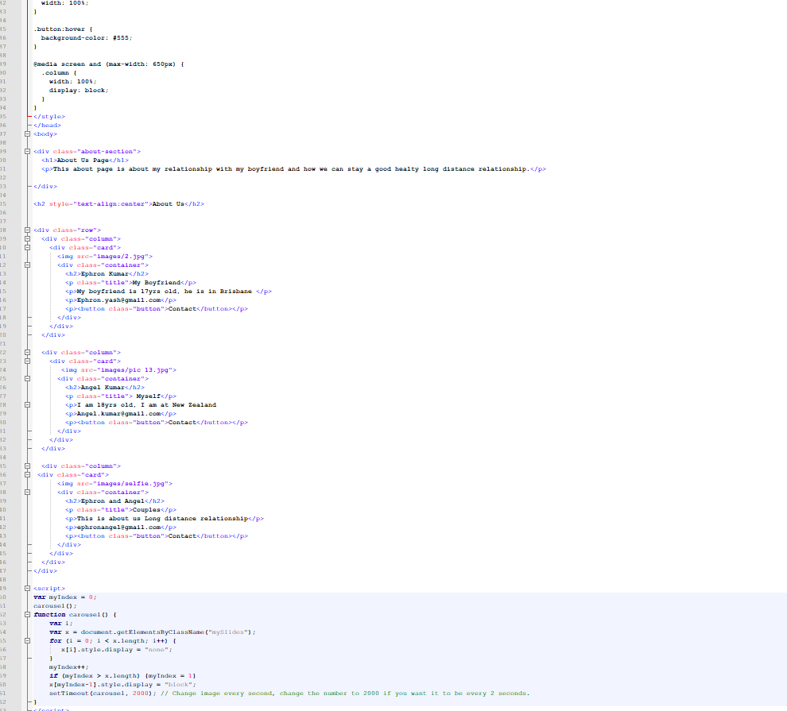
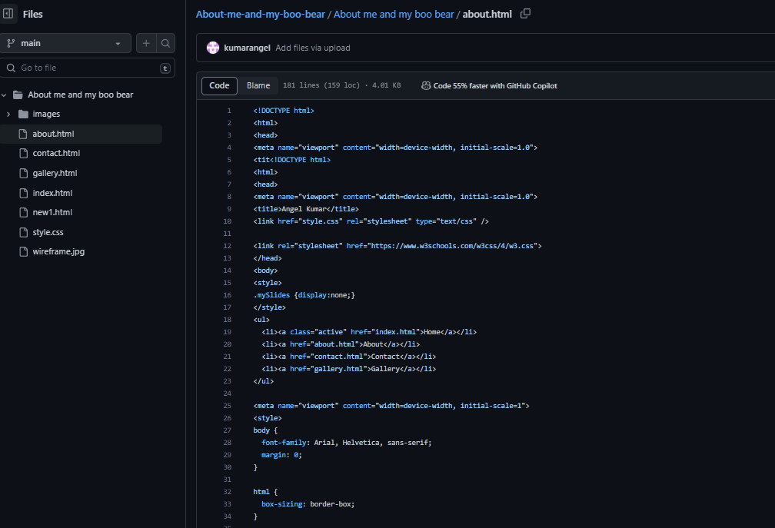
Coding:html,css,javascript

Slide 7
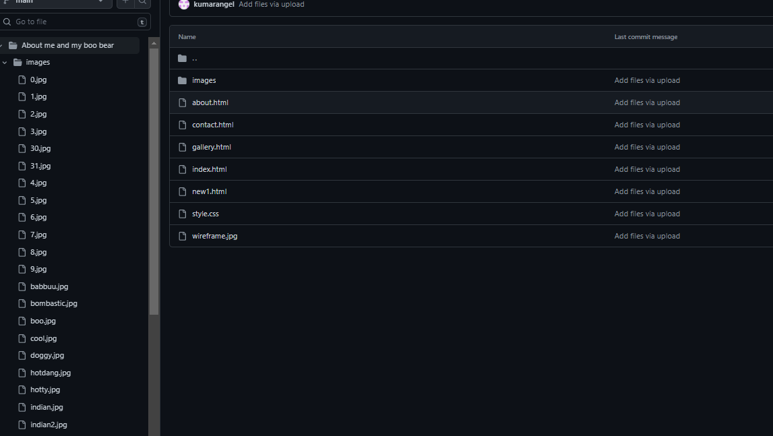
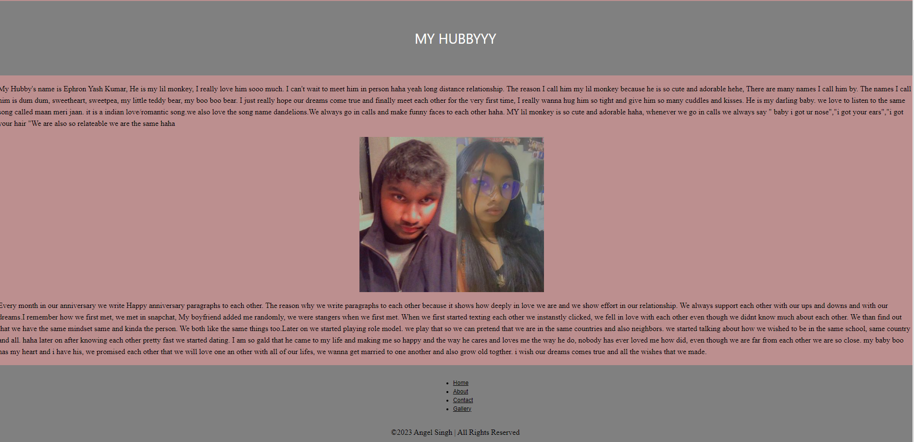
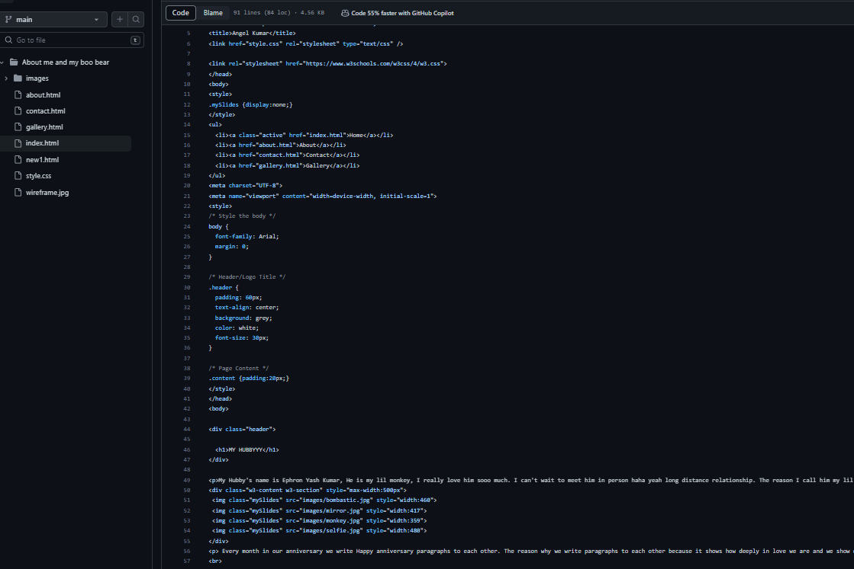
Coding:html,css,javascript

Slide 8
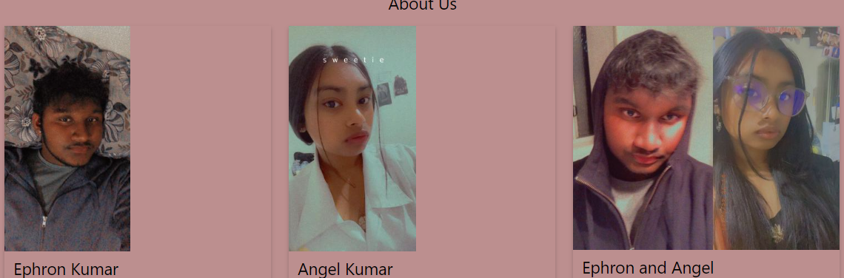
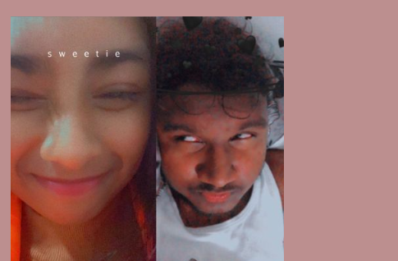
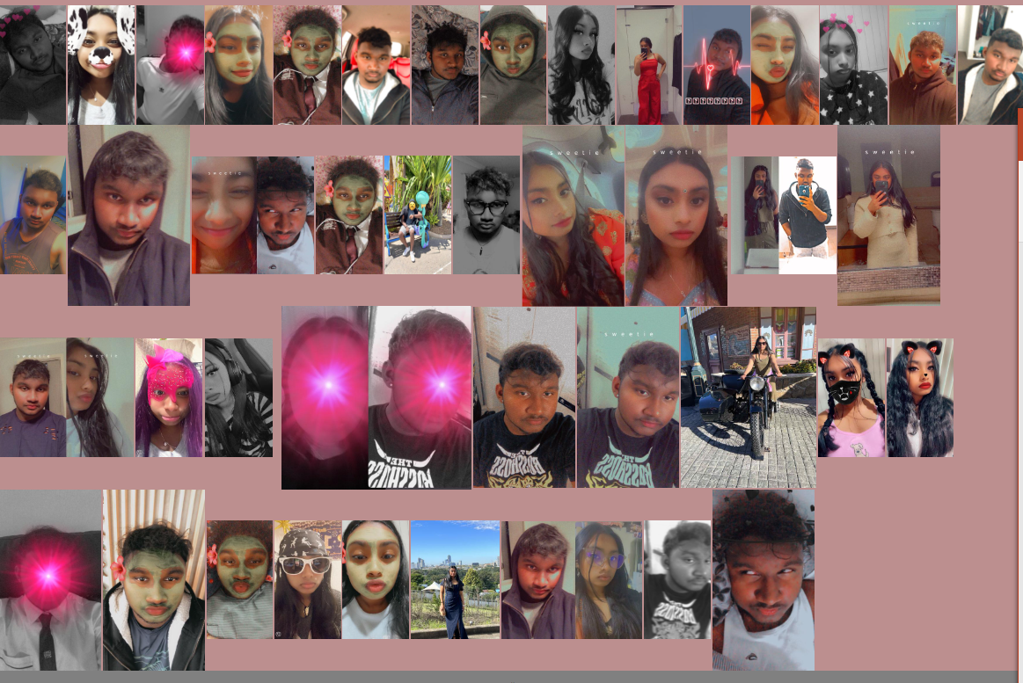
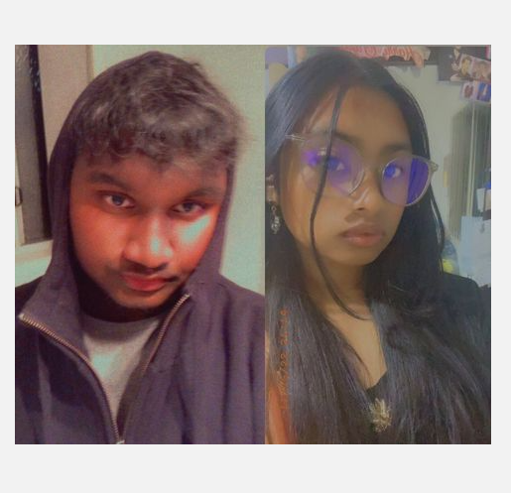
Coding:html,css,javascript checking the codes to see if it working.
About us page
homepage
Contact page
Gallery page

Slide 9
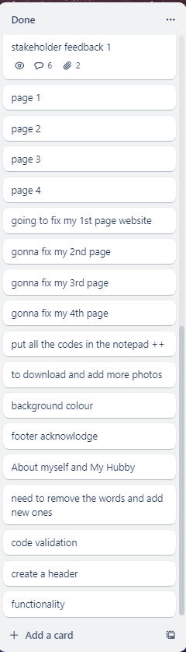
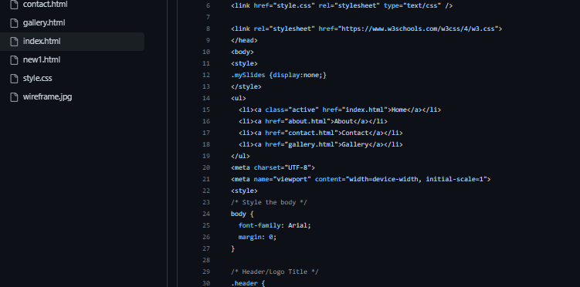
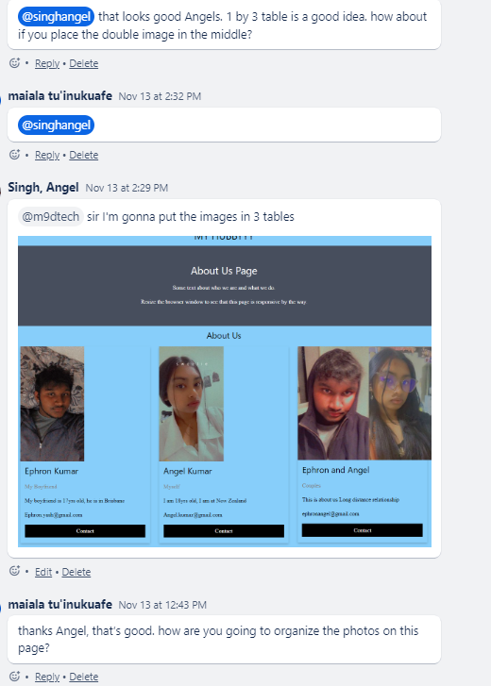
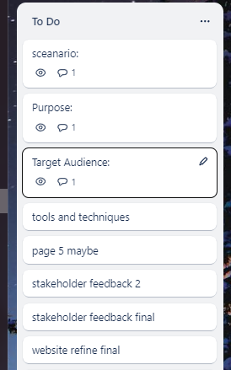
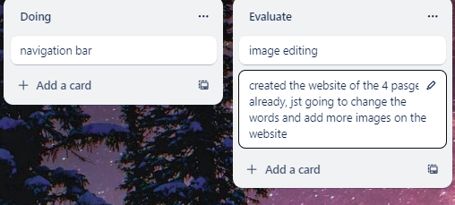
Project Management Evidence of writing the codes.

Slide 10
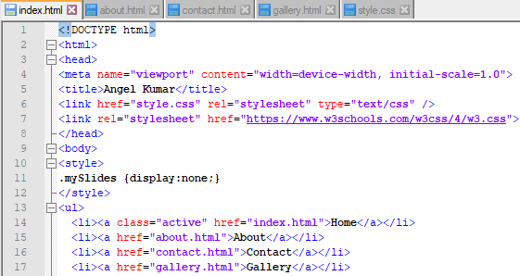
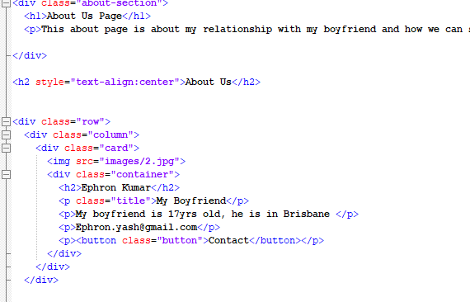
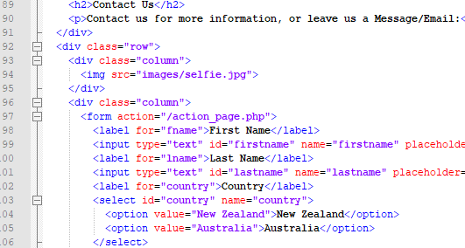
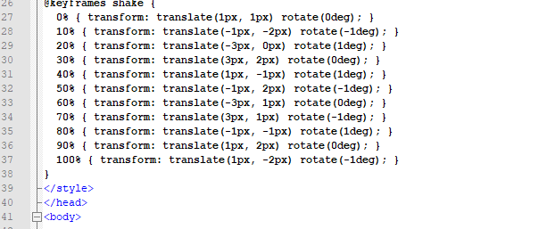
Duplicating the main website
about
index
contact
gallery

Slide 11
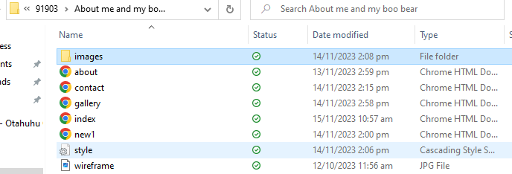
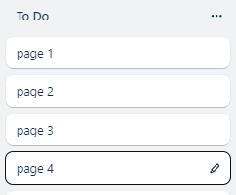
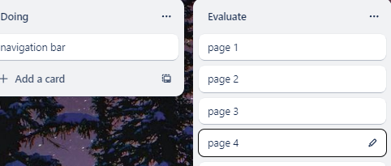
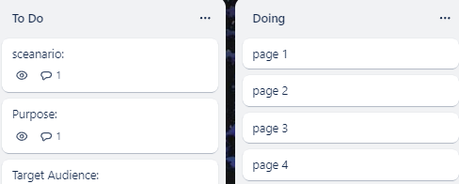
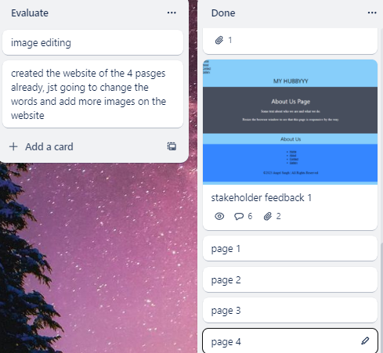
Duplicating the main webpage

Slide 12
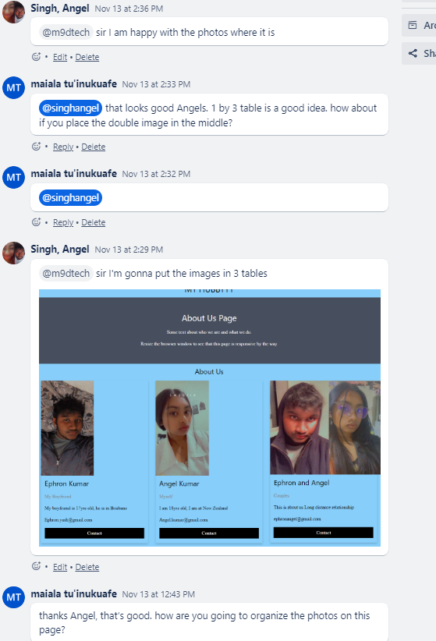
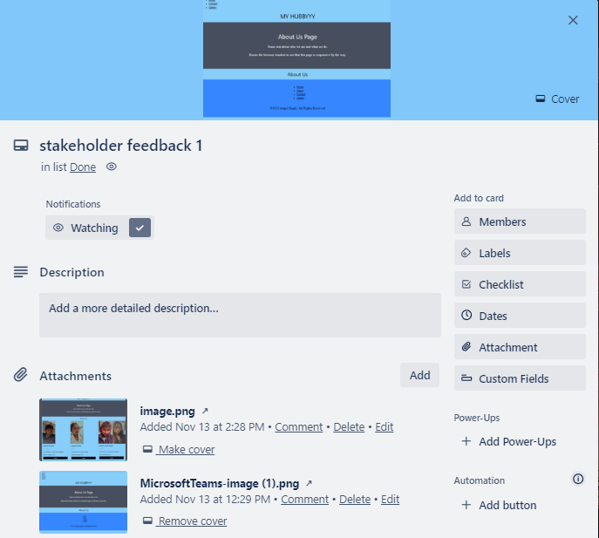
Feedback/Discussion1
Refine1

Slide 13
Relevant Implications
Copyright- all of my images that I downloaded from my phone belongs to myself and my boyfriend, I would also like to acknowledge ourselves. I used all the image for education purposes for my website.
Ethical- all my images and text are all about me and my bf, there is nothing that can harm people in anyway. This website is about how me and him came close to each other and how we can keep our relationship stronger and healthy even though we are in a long distance relationship.
Functionality – This website site behaves smoothly according to its purpose. The main functions which are is to provide information about us and to provide some kind of help and communication for those who needs help with the relationship issues so we can give you support. The website works smoothly on all web browsers, it loads perfectly and fast, all the images works well, the colour of the website attracts the audiences, the fonts and the font colour is easy to read. The website display will run in different screen size will go perfectly

